Slide 1
Sliced optimal partial transport

Slide 2
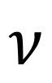
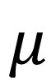
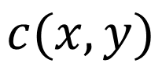
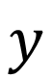
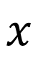
Introduction of Optimal transport
$$c(x,y)$$
$$x$$
$$y$$
$$ν$$
$$μ$$

Slide 3
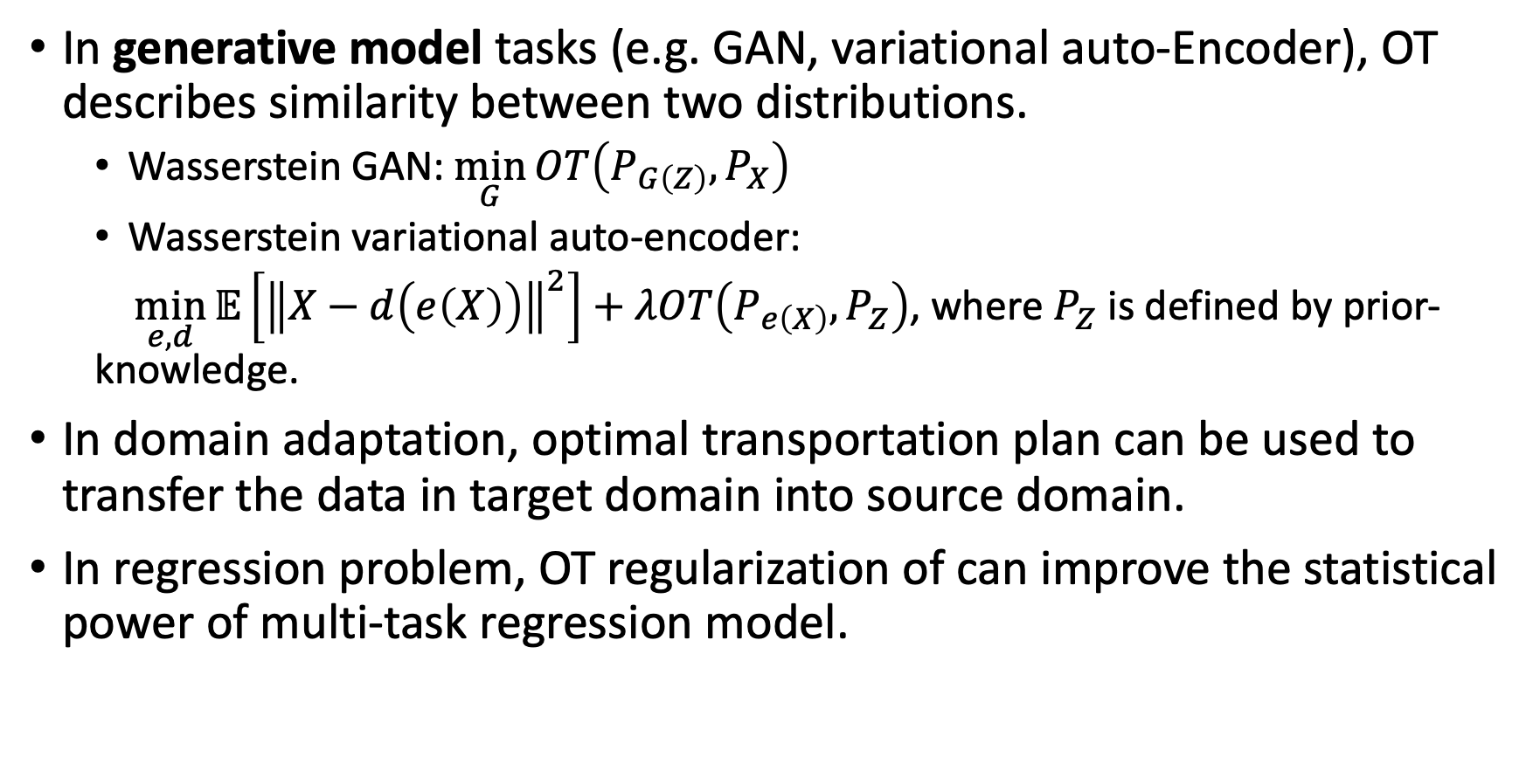
Applications of OT
In generative model tasks (e.g. GAN, variational auto-Encoder), OT describes similarity between two distributions.
Wasserstein GAN: $\min_{G}{OT\left(P_{G\left(Z\right)},P_{X}\right)}$
Wasserstein variational auto-encoder:
$\min_{e,d}{𝔼\left[{\left\|X−d\left(e\left(X\right)\right)\right\|}^{2}\right]+λOT\left(P_{e\left(X\right)},P_{Z}\right)}$, where $P_{Z}$ is defined by prior-knowledge.
In domain adaptation, optimal transportation plan can be used to transfer the data in target domain into source domain.
In regression problem, OT regularization of can improve the statistical power of multi-task regression model.

Slide 4
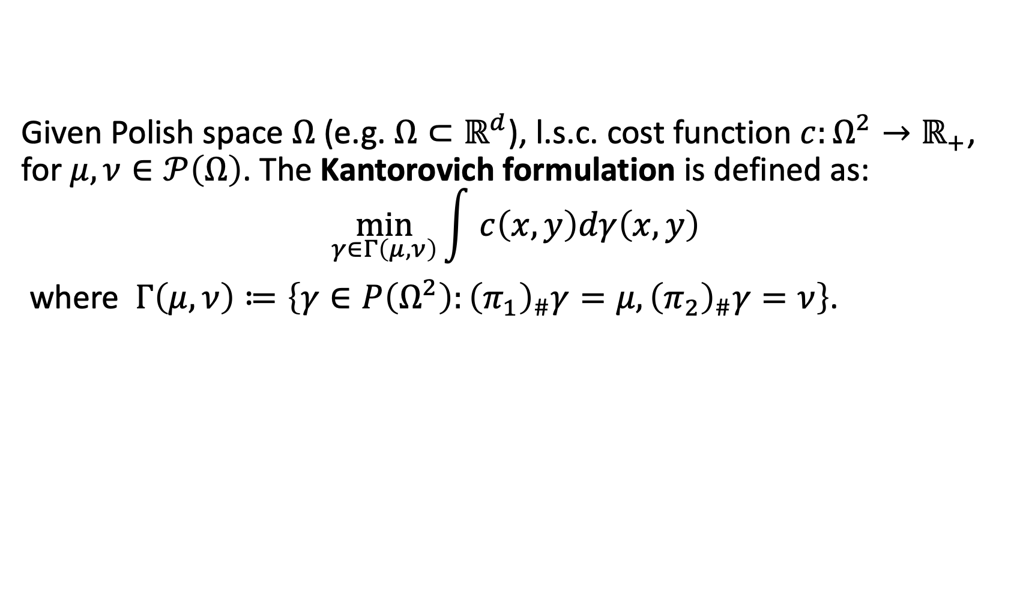
Background: Kantorovich formulation
Given Polish space $Ω$ (e.g. $Ω⊂ℝ^{d}$), l.s.c. cost function $c:Ω^{2}→ℝ_{+}$, for $μ,ν∈𝒫\left(Ω\right)$. The Kantorovich formulation is defined as: $$\min_{γ∈Γ\left(μ,ν\right)}{\int{ c\left(x,y\right)dγ\left(x,y\right)}}$$
where $Γ\left(μ,ν\right)≔\left\{γ∈P\left(Ω^{2}\right):{\left(π_{1}\right)}_{\#}γ=μ,{\left(π_{2}\right)}_{\#}γ=ν\right\}$.

Slide 5
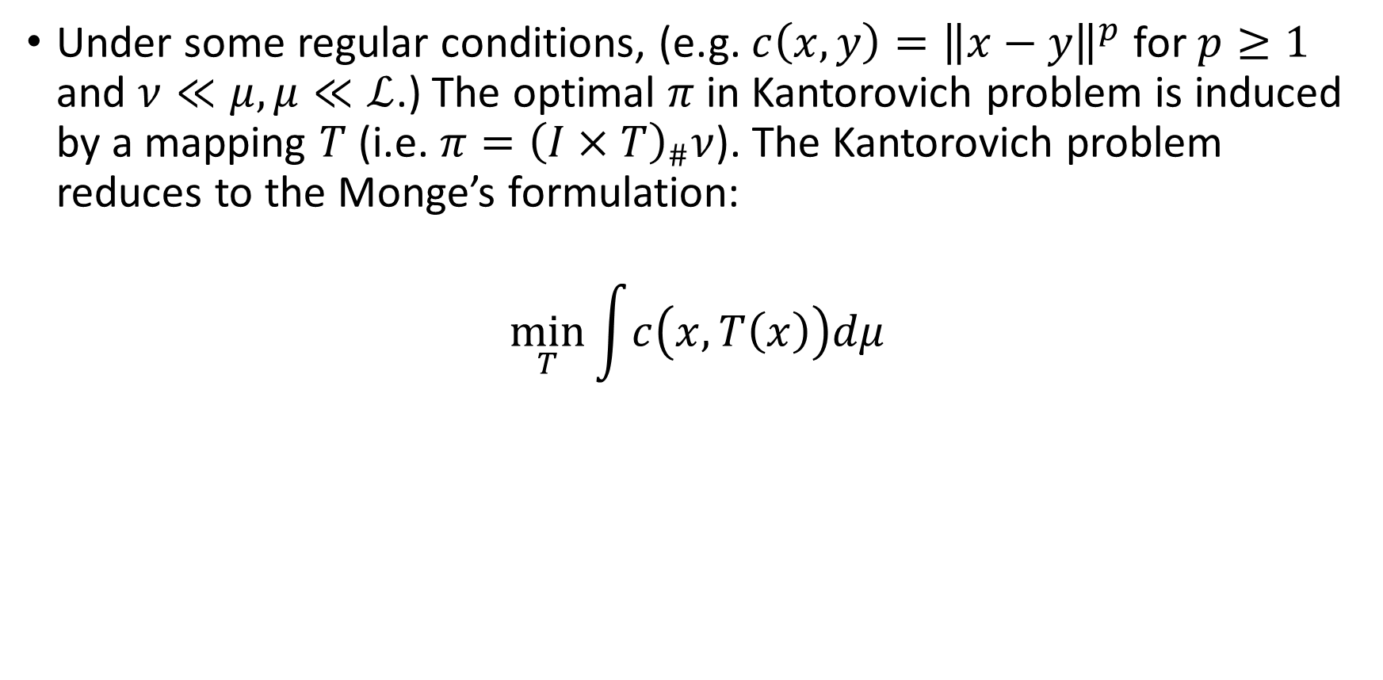
Monge’s formulation
Under some regular conditions, (e.g. $c\left(x,y\right)={\left\|x−y\right\|}^{p}$ for $p≥1$ and $ν≪μ,μ≪ℒ$.) The optimal $π$ in Kantorovich problem is induced by a mapping $T$ (i.e. $π={\left(I×T\right)}_{\#}ν$). The Kantorovich problem reduces to the Monge’s formulation:
$$\min_{T}{\int{c\left(x,T\left(x\right)\right)dμ}}$$

Slide 6
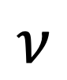
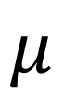
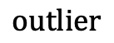
Optimal partial transport (OPT)
$$μ$$
$$outlier$$
outliers
$$ν$$
Motivation: we aim to find a Kantorovich style formulation such that for unnormalized measures.

Slide 7
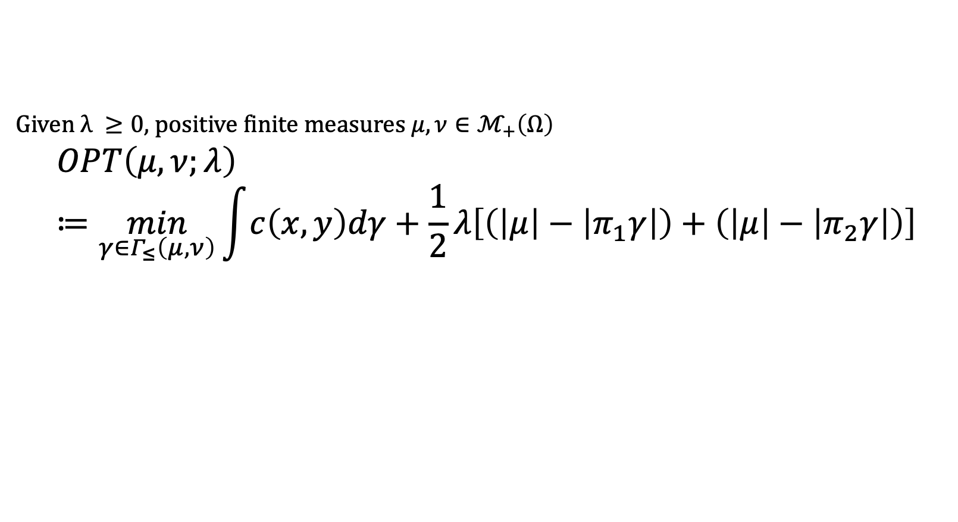
Background: optimal partial transport (OPT)
Given $λ ≥0$, positive finite measures $μ,ν∈ℳ_{+}\left(Ω\right)$
$$OPT\left(μ,ν;λ\right)≔\min_{γ∈Γ_{≤}\left(μ,ν\right)}{\int{c\left(x,y\right)dγ}+\frac{1}{2}λ\left[\left(\left|μ\right|−\left|π_{1}γ\right|\right)+\left(\left|μ\right|−\left|π_{2}γ\right|\right)\right]}$$
Transportation cost
Mass destruction
mass creation

Slide 8
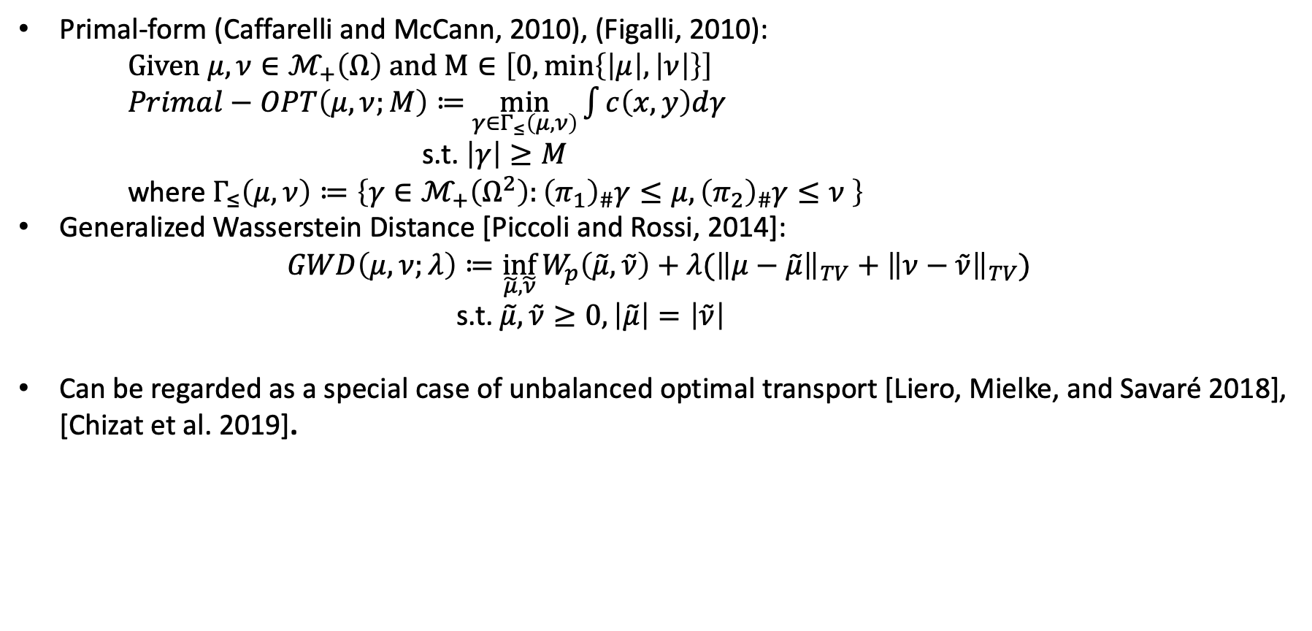
Other equivalent formulations of OPT
Primal-form (Caffarelli and McCann, 2010), (Figalli, 2010):
Given $μ,ν∈ℳ_{+}\left(Ω\right)$ and $M∈\left[0,\min\left\{\left|μ\right|,\left|ν\right|\right\}\right]$
$Primal−OPT\left(μ,ν;M\right)≔$ $\min_{γ∈Γ_{≤}\left(μ,ν\right)}{\int{c\left(x,y\right)dγ}}$
s.t. $\left|γ\right|≥M$
where $Γ_{≤}\left(μ,ν\right)≔\left\{γ∈ℳ_{+}\left(Ω^{2}\right):{\left(π_{1}\right)}_{\#}γ≤μ,{\left(π_{2}\right)}_{\#}γ≤ν \right\}$
Generalized Wasserstein Distance [Piccoli and Rossi, 2014]:
$$GWD\left(μ,ν;λ\right)≔\inf_{\tilde{μ},\tilde{ν}}{W_{p}\left(\tilde{μ},\tilde{ν}\right)+λ({\left\|μ−\tilde{μ}\right\|}_{TV}+{\left\|ν−\tilde{ν}\right\|}_{TV}})$$
s.t. $\tilde{μ},\tilde{ν}≥0,\left|\tilde{μ}\right|=\left|\tilde{ν}\right|$
Can be regarded as a special case of unbalanced optimal transport [Liero, Mielke, and Savaré 2018], [Chizat et al. 2019].

Slide 9
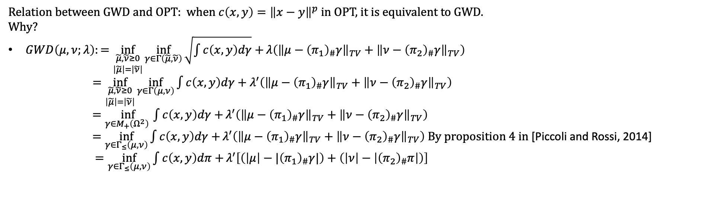
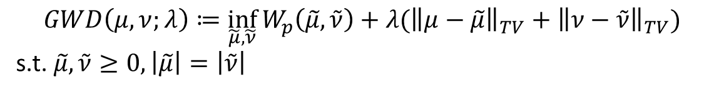
History of formulations of OPT
Generalized Wasserstein Distance [Piccoli and Rossi, 2014]:
$$GWD\left(μ,ν;λ\right)≔\inf_{\tilde{μ},\tilde{ν}}{W_{p}\left(\tilde{μ},\tilde{ν}\right)+λ({\left\|μ−\tilde{μ}\right\|}_{TV}+{\left\|ν−\tilde{ν}\right\|}_{TV}})$$
s.t. $\tilde{μ},\tilde{ν}≥0,\left|\tilde{μ}\right|=\left|\tilde{ν}\right|$
Relation between GWD and OPT: when $c\left(x,y\right)={\left\|x−y\right\|}^{p}$ in OPT, it is equivalent to GWD. Why?
$GWD\left(μ,ν;λ\right):=\inf_{\begin{aligned}\tilde{μ},\tilde{ν}≥0 \\ \left|\tilde{μ}\right|=\left|\tilde{ν}\right|\end{aligned}}{\inf_{γ∈Γ\left(\tilde{μ},\tilde{ν}\right)}{\sqrt{\int{c\left(x,y\right)dγ}}+}λ\left({\left\|μ−{\left(π_{1}\right)}_{\#}γ\right\|}_{TV}+{\left\|ν−{\left(π_{2}\right)}_{\#}γ\right\|}_{TV}\right)}$
$=\inf_{\begin{aligned}\tilde{μ},\tilde{ν}≥0 \\ \left|\tilde{μ}\right|=\left|\tilde{ν}\right|\end{aligned}}{\inf_{γ∈Γ\left(μ,ν\right)}{\int{c\left(x,y\right)dγ}}+λ^{′}\left({\left\|μ−{\left(π_{1}\right)}_{\#}γ\right\|}_{TV}+{\left\|ν−{\left(π_{2}\right)}_{\#}γ\right\|}_{TV}\right)}$
$=\inf_{γ∈M_{+}\left(Ω^{2}\right) }{\int{c\left(x,y\right)dγ}+}λ^{′}\left({\left\|μ−{\left(π_{1}\right)}_{\#}γ\right\|}_{TV}+{\left\|ν−{\left(π_{2}\right)}_{\#}γ\right\|}_{TV}\right)$
$=\inf_{γ∈Γ_{≤}\left(μ,ν\right)}{\int{c\left(x,y\right)dγ}+}λ^{′}\left({\left\|μ−{\left(π_{1}\right)}_{\#}γ\right\|}_{TV}+{\left\|ν−{\left(π_{2}\right)}_{\#}γ\right\|}_{TV}\right)$ By proposition 4 in [Piccoli and Rossi, 2014]
$=\inf_{γ∈Γ_{≤}\left(μ,ν\right)}{\int{c\left(x,y\right)dπ}+}λ^{′}\left[\left(\left|μ\right|−{|\left(π_{1}\right)}_{\#}γ|\right)+\left(\left|ν\right|−\left|{\left(π_{2}\right)}_{\#}π\right|\right)\right]$

Slide 10
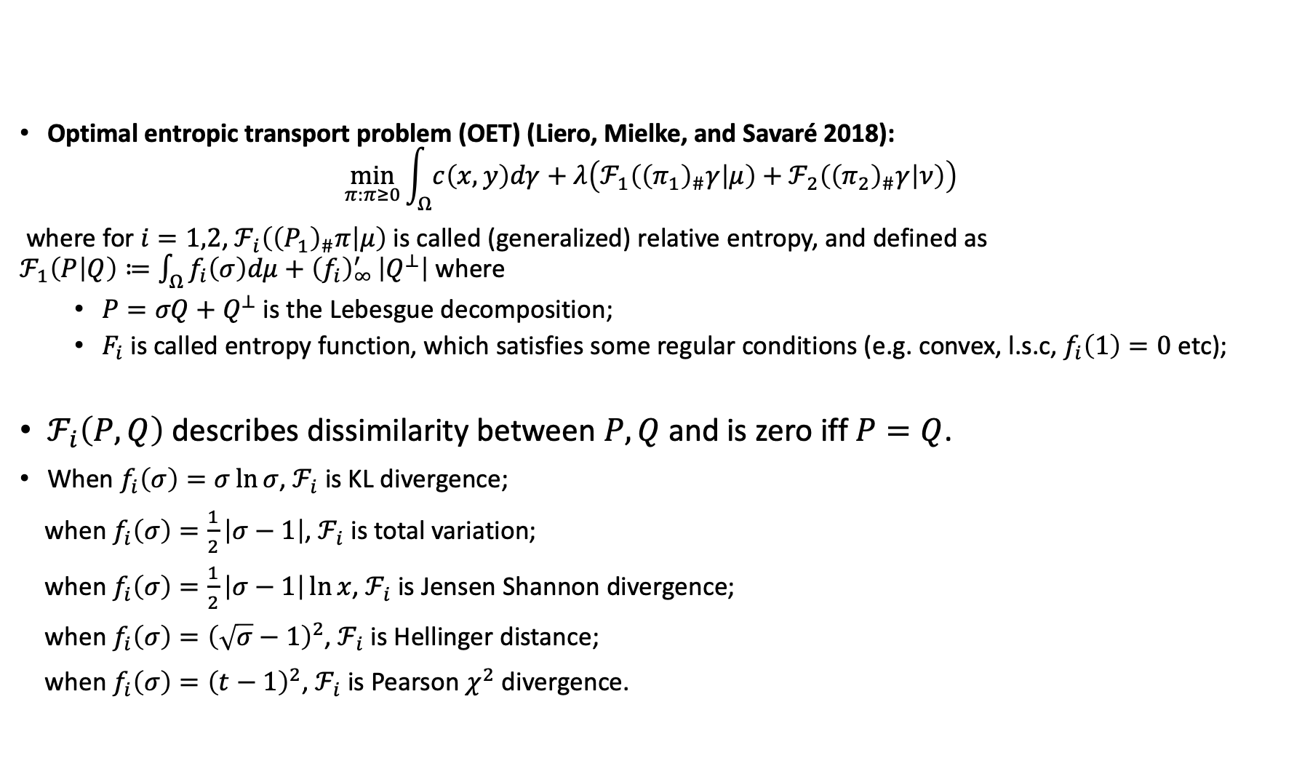
Generalization of OPT: Unbalanced OT
Optimal entropic transport problem (OET) (Liero, Mielke, and Savaré 2018):
$$\min_{π:π≥0}{\int_{Ω}{c\left(x,y\right)dγ}+λ\left(ℱ_{1}\left({\left(π_{1}\right)}_{\#}γ | μ\right)+ℱ_{2}\left({\left(π_{2}\right)}_{\#}γ | ν\right)\right)}$$
where for $i=1,2$, $ℱ_{i}\left({\left(P_{1}\right)}_{\#}π | μ\right)$ is called (generalized) relative entropy, and defined as $ℱ_{1}\left(P | Q\right)≔\int_{Ω}{f_{i}\left(σ\right)dμ+{\left(f_{i}\right)}_{∞}^{′}}\left|Q^{⊥}\right|$ where
$P=σQ+Q^{⊥}$ is the Lebesgue decomposition;
$F_{i}$ is called entropy function, which satisfies some regular conditions (e.g. convex, l.s.c, $f_{i}\left(1\right)=0$ etc);
$ℱ_{i}\left(P,Q\right)$ describes dissimilarity between $P,Q$ and is zero iff $P=Q$.
When $f_{i}\left(σ\right)=σ\ln{σ}$, $ℱ_{i}$ is KL divergence;
when $f_{i}\left(σ\right)=\frac{1}{2}\left|σ−1\right|$, $ℱ_{i}$ is total variation;
when $f_{i}\left(σ\right)=\frac{1}{2}\left|σ−1\right|\ln{x}$, $ℱ_{i}$ is Jensen Shannon divergence;
when $f_{i}\left(σ\right)={\left(\sqrt{σ}−1\right)}^{2}$, $ℱ_{i}$ is Hellinger distance;
when $f_{i}\left(σ\right)={\left(t−1\right)}^{2}$, $ℱ_{i}$ is Pearson $χ^{2}$ divergence.

Slide 11
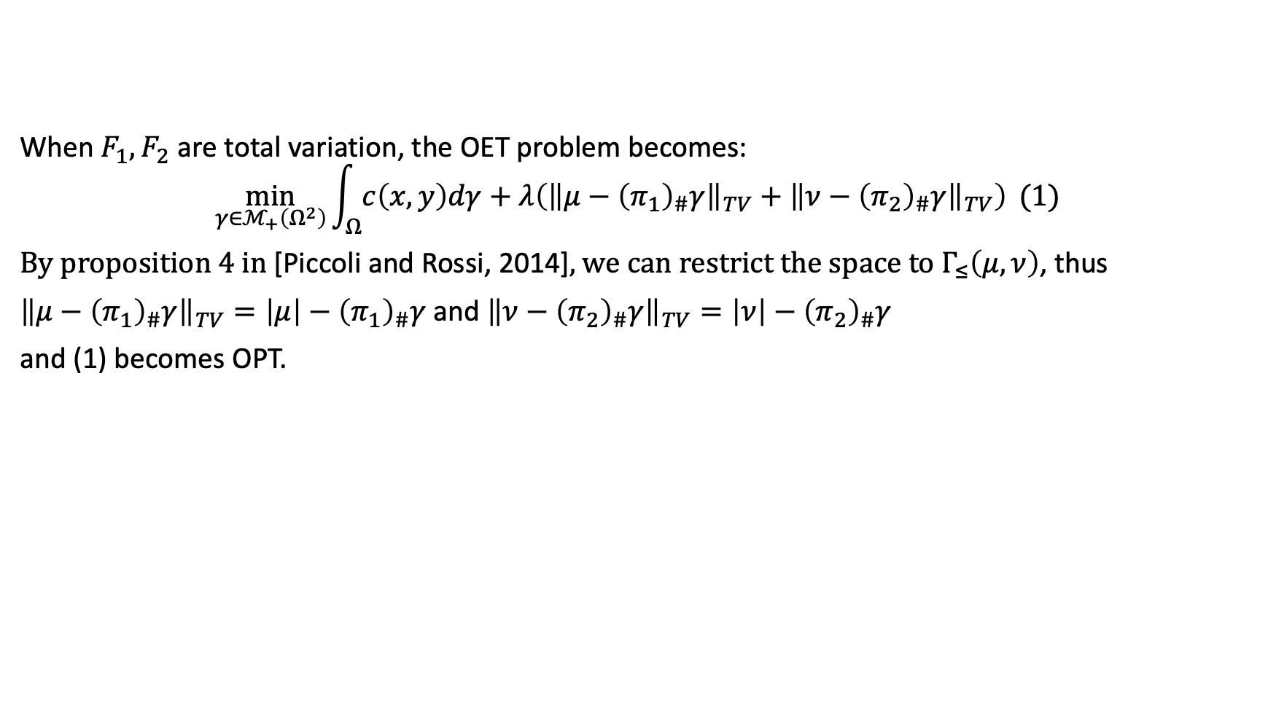
Relation between OET and OPT
When $F_{1},F_{2}$ are total variation, the OET problem becomes:
$$\min_{γ∈ℳ_{+}\left(Ω^{2}\right)}{\int_{Ω}{c\left(x,y\right)dγ}+λ\left({\left\|μ−{\left(π_{1}\right)}_{\#}γ\right\|}_{TV}+{\left\|ν−{\left(π_{2}\right)}_{\#}γ\right\|}_{TV}\right)} (1)$$
By proposition 4 in [Piccoli and Rossi, 2014], we can restrict the space to $Γ_{≤}\left(μ,ν\right)$, thus
${\left\|μ−{\left(π_{1}\right)}_{\#}γ\right\|}_{TV}=\left|μ\right|−{\left(π_{1}\right)}_{\#}γ$ and ${\left\|ν−{\left(π_{2}\right)}_{\#}γ\right\|}_{TV}=\left|ν\right|−{\left(π_{2}\right)}_{\#}γ$
and (1) becomes OPT.

Slide 12
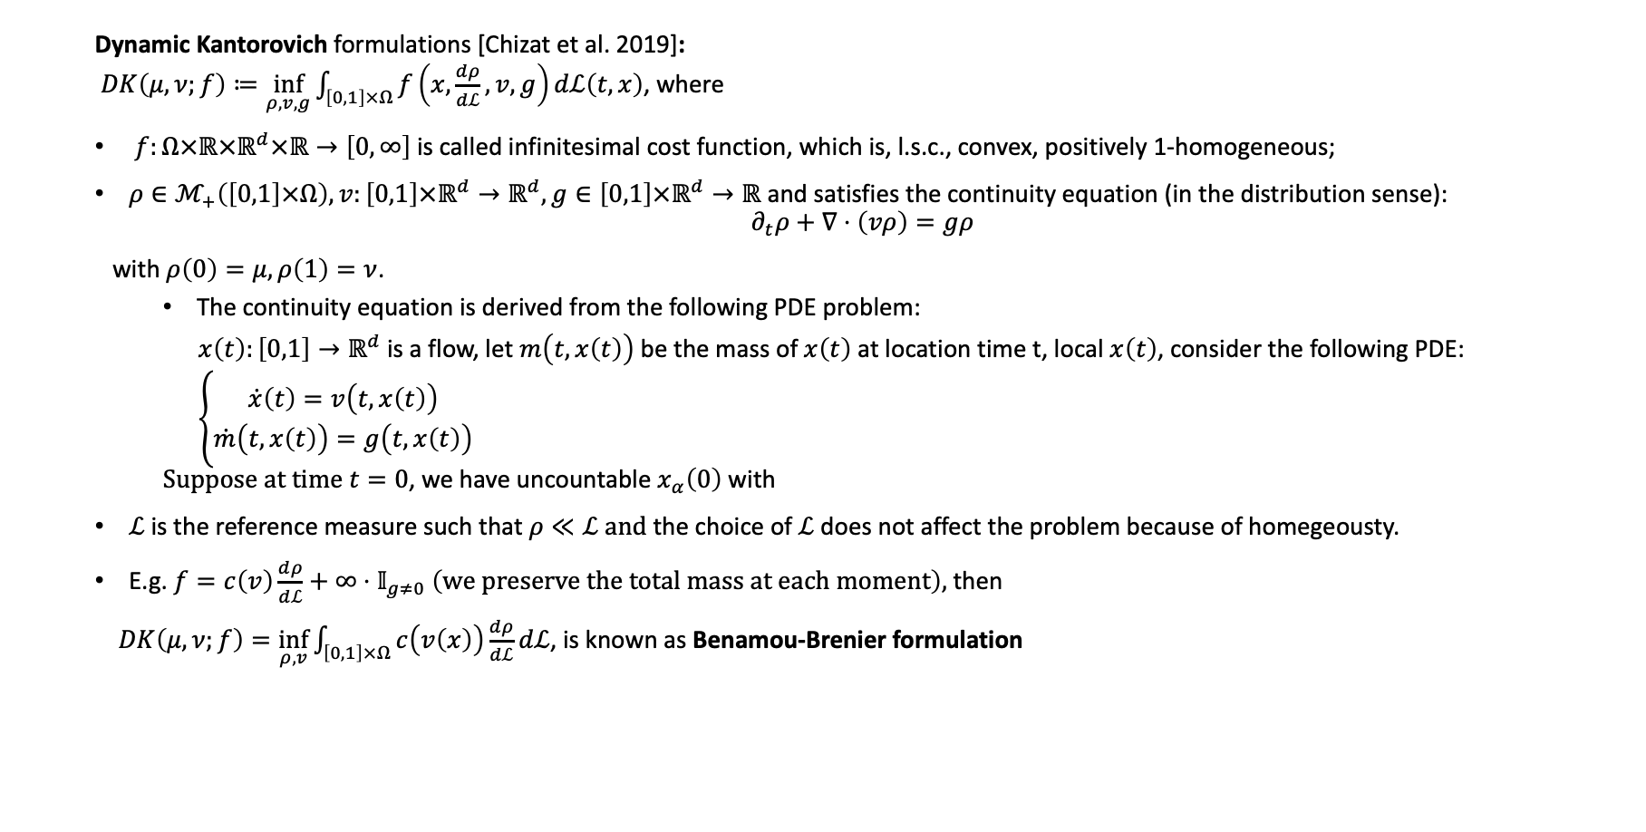
Generalization of OPT: Unbalanced OT
Dynamic Kantorovich formulations [Chizat et al. 2019]: $DK\left(μ,ν;f\right)≔\inf_{ρ,v,g}{\int_{\left[0,1\right]×Ω}{f\left(x,\frac{dρ}{dℒ},v,g\right)dℒ\left(t,x\right)}}$, where
$f:Ω×ℝ×ℝ^{d}×ℝ→\left[0,∞\right]$ is called infinitesimal cost function, which is, l.s.c., convex, positively 1-homogeneous;
$ρ∈ℳ_{+}\left(\left[0,1\right]×Ω\right),v:\left[0,1\right]×ℝ^{d}→ℝ^{d},g∈\left[0,1\right]×ℝ^{d}→ℝ$ and satisfies the continuity equation (in the distribution sense):
$$∂_{t}ρ+∇⋅\left(vρ\right)=gρ$$
with $ρ\left(0\right)=μ,ρ\left(1\right)=ν$.
The continuity equation is derived from the following PDE problem:
$x\left(t\right):\left[0,1\right]→ℝ^{d}$ is a flow, let $m\left(t,x\left(t\right)\right)$ be the mass of $x\left(t\right)$ at location time t, local $x\left(t\right)$, consider the following PDE:
$\left\{\begin{aligned}\dot{x}\left(t\right)=v\left(t,x\left(t\right)\right) \\ \dot{m}\left(t,x\left(t\right)\right)=g\left(t,x\left(t\right)\right)\end{aligned}\right.$ Suppose at time $t=0$, we have uncountable $x_{α}\left(0\right)$ with
$ℒ$ is the reference measure such that $ρ≪ℒ and$the choice of $ℒ$ does not affect the problem because of homegeousty.
E.g. $f=c\left(v\right)\frac{dρ}{dℒ}+∞⋅𝕀_{g≠0} \left(we preserve the total mass at each moment\right),$then
$DK\left(μ, ν;f\right)=\inf_{ρ,v}\int_{\left[0,1\right]×Ω}{c\left(v\left(x\right)\right)\frac{dρ}{dℒ}}dℒ$, is known as Benamou-Brenier formulation

Slide 13
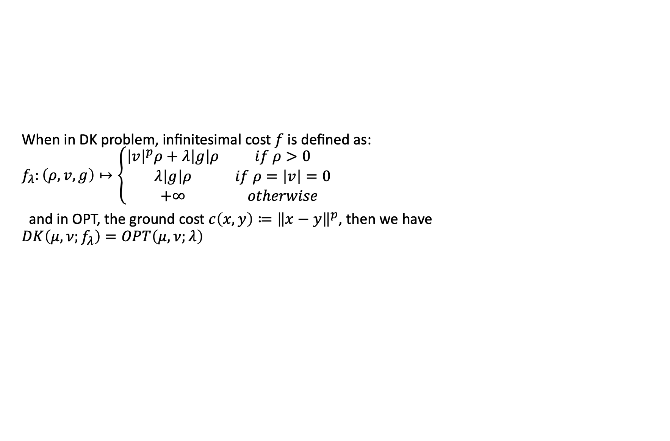
Relation between DK and OPT
When in DK problem, infinitesimal cost $f$ is defined as: $f_{λ}:\left(ρ,v,g\right)↦\left\{\begin{matrix}{\left|v\right|}^{p}ρ+λ\left|g\right|ρ & if ρ>0 \\ λ\left|g\right|ρ & if ρ=\left|v\right|=0 \\ +∞ & otherwise\end{matrix}\right.$
and in OPT, the ground cost $c\left(x,y\right)≔{\left\|x−y\right\|}^{p}$, then we have $DK\left(μ,ν;f_{λ}\right)=OPT\left(μ,ν;λ\right)$

Slide 14
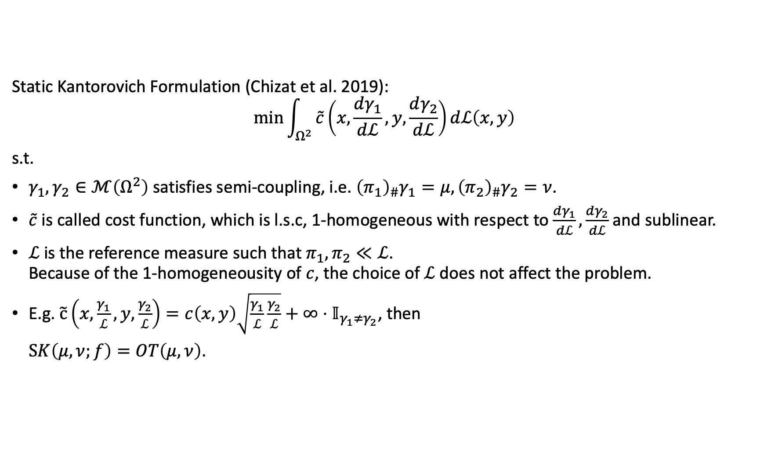
Generalization of OPT: Unbalanced OT
Static Kantorovich Formulation (Chizat et al. 2019):
$$\min{\int_{Ω^{2}}{\tilde{c}\left(x,\frac{dγ_{1}}{dℒ},y,\frac{dγ_{2}}{dℒ}\right)dℒ\left(x,y\right)}}$$
s.t.
$γ_{1},γ_{2}∈ℳ\left(Ω^{2}\right)$ satisfies semi-coupling, i.e. ${\left(π_{1}\right)}_{\#}γ_{1}=μ,{\left(π_{2}\right)}_{\#}γ_{2}=ν$.
$\tilde{c}$ is called cost function, which is l.s.c, 1-homogeneous with respect to $\frac{dγ_{1}}{dℒ},\frac{dγ_{2}}{dℒ}$ and sublinear.
$ℒ$ is the reference measure such that $π_{1},π_{2}≪ℒ$. Because of the 1-homogeneousity of $c$, the choice of $ℒ$ does not affect the problem.
E.g. $\tilde{c}\left(x,\frac{γ_{1}}{ℒ},y,\frac{γ_{2}}{ℒ}\right)=c\left(x,y\right)\sqrt{\frac{γ_{1}}{ℒ}\frac{γ_{2}}{ℒ}}+∞⋅𝕀_{γ_{1}≠γ_{2}}$, then
$SK\left(μ, ν;f\right)=OT\left(μ,ν\right)$.

Slide 15
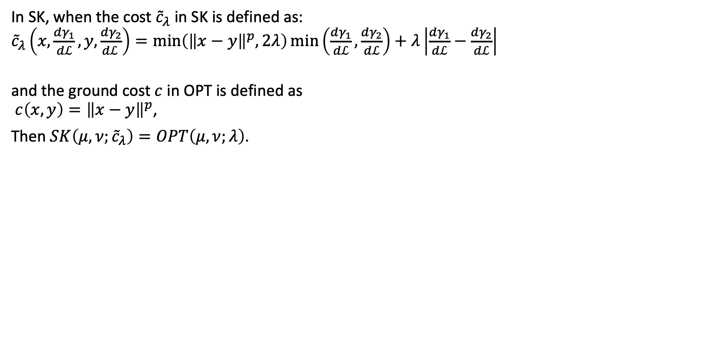
Relation between SK and OPT
In SK, when the cost ${\tilde{c}}_{λ}$ in SK is defined as: ${\tilde{c}}_{λ}\left(x,\frac{dγ_{1}}{dℒ},y,\frac{dγ_{2}}{dℒ }\right)=\min\left({\left\|x−y\right\|}^{p},2λ\right)\min\left(\frac{dγ_{1}}{dℒ},\frac{dγ_{2}}{dℒ}\right)+λ\left|\frac{dγ_{1}}{dℒ}−\frac{dγ_{2}}{dℒ}\right|$
and the ground cost $c$ in OPT is defined as $c\left(x,y\right)={\left\|x−y\right\|}^{p}$,
Then $SK\left(μ,ν;{\tilde{c}}_{λ}\right)=OPT\left(μ,ν;λ\right)$.

Slide 16
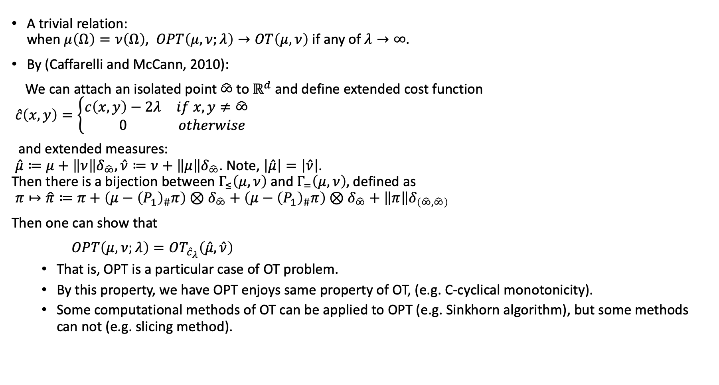
Relation of OT and OPT
A trivial relation: when $μ\left(Ω\right)=ν\left(Ω\right)$, $OPT\left(μ,ν;λ\right)→OT\left(μ,ν\right)$ if any of $λ→∞$.
By (Caffarelli and McCann, 2010):
We can attach an isolated point $\hat{∞}$ to $ℝ^{d}$ and define extended cost function $\hat{c}\left(x,y\right)=\left\{\begin{matrix}c\left(x,y\right)−2λ & if x,y≠\hat{∞} \\ 0 & otherwise\end{matrix}\right.$
and extended measures: $\hat{μ}≔μ+\left\|ν\right\|δ_{\hat{∞}},\hat{ν}≔ν+\left\|μ\right\|δ_{\hat{∞}}$. Note, $\left|\hat{μ}\right|=\left|\hat{ν}\right|$. Then there is a bijection between $Γ_{≤}\left(μ,ν\right)$ and $Γ_{=}\left(μ,ν\right),$defined as $π↦\hat{π}≔π+\left(μ−{\left(P_{1}\right)}_{\#}π\right)⊗δ_{\hat{∞}}+\left(μ−{\left(P_{1}\right)}_{\#}π\right)⊗δ_{\hat{∞}}+\left\|π\right\|δ_{\left(\hat{∞},\hat{∞}\right)}$
Then one can show that
$OPT\left(μ,ν;λ\right)=OT_{{\hat{c}}_{λ}}\left(\hat{μ},\hat{ν}\right)$
That is, OPT is a particular case of OT problem.
By this property, we have OPT enjoys same property of OT, (e.g. C-cyclical monotonicity).
Some computational methods of OT can be applied to OPT (e.g. Sinkhorn algorithm), but some methods can not (e.g. slicing method).

Slide 17


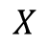
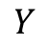
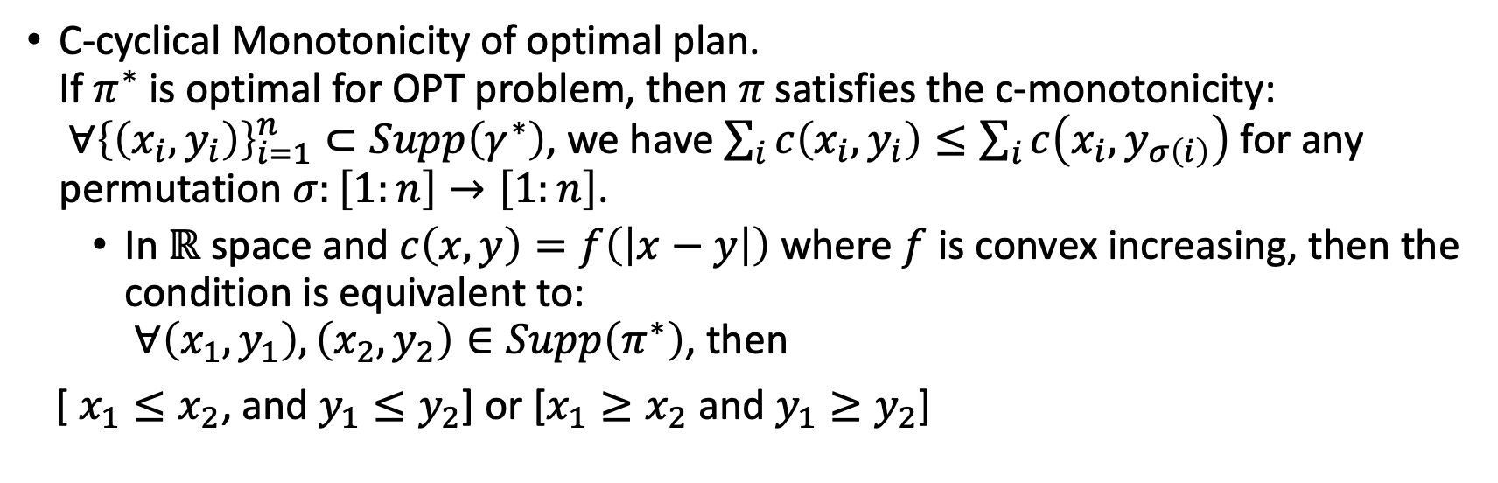
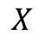
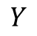
Basic properties of OPT
C-cyclical Monotonicity of optimal plan. If $π^{∗}$ is optimal for OPT problem, then $π$ satisfies the c-monotonicity: $∀{\left\{\left(x_{i},y_{i}\right)\right\}}_{i=1}^{n}⊂Supp\left(γ^{∗}\right)$, we have $\sum_{i}{c\left(x_{i},y_{i}\right)}≤\sum_{i}{c\left(x_{i},y_{σ\left(i\right)}\right)}$ for any permutation $σ:\left[1:n\right]→\left[1:n\right]$.
In $ℝ$ space and $c\left(x,y\right)=f\left(\left|x−y\right|\right)$ where $f$ is convex increasing, then the condition is equivalent to: $∀\left(x_{1},y_{1}\right),\left(x_{2},y_{2}\right)∈Supp\left(π^{∗}\right)$, then
[ $x_{1}≤x_{2}$, and $y_{1}≤y_{2}$] or [$x_{1}≥x_{2}$ and $y_{1}≥y_{2}$]
$$X$$
$$X$$
$$Y$$
$$Y$$

Slide 18
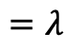
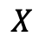
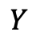
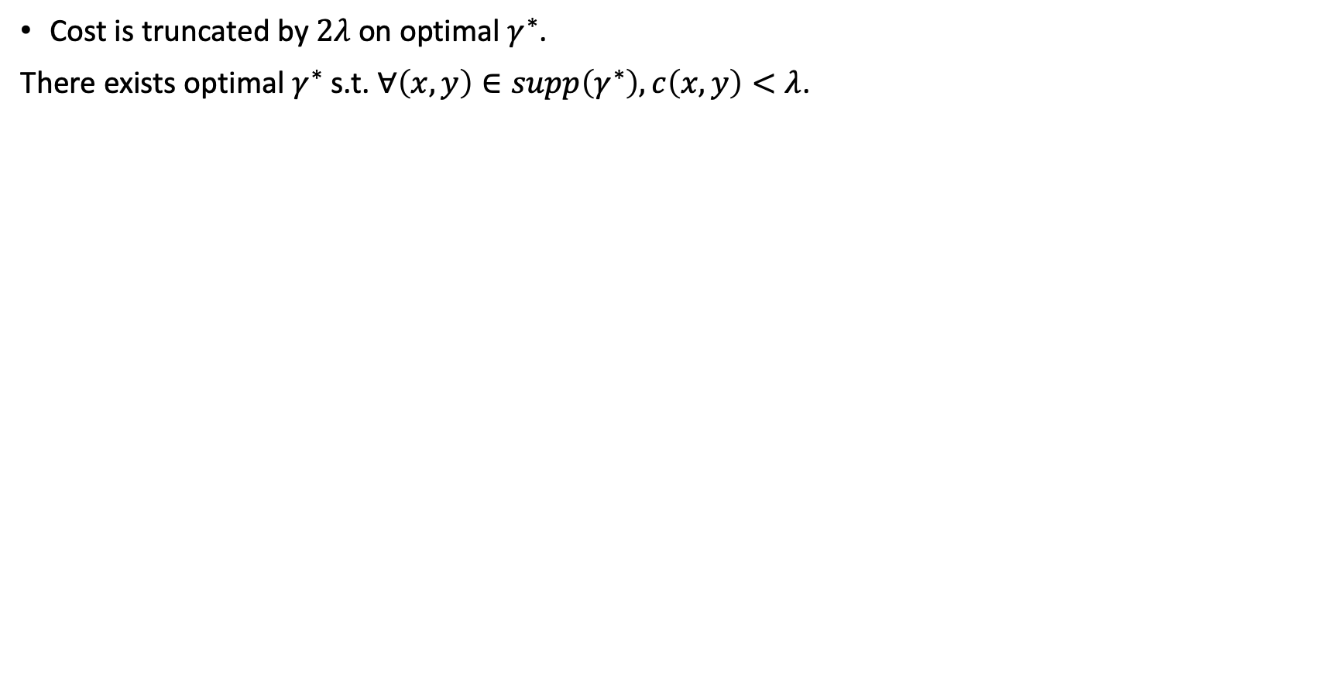
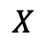
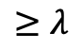
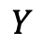
Basic properties of OPT
Cost is truncated by $2λ$ on optimal $γ^{∗}$.
There exists optimal $γ^{∗}$ s.t. $∀\left(x,y\right)∈supp\left(γ^{∗}\right),c\left(x,y\right)<λ$.
$$X$$
$$X$$
$$≥λ$$
$$=λ$$
$$Y$$
$$Y$$

Slide 19
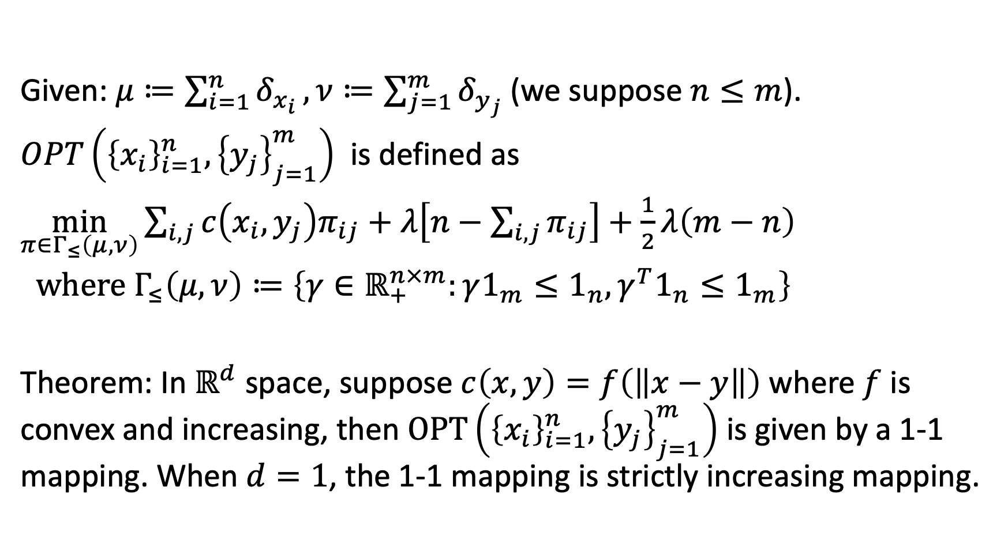
Empirical OPT
Given: $μ≔\sum_{i=1}^{n}{δ_{x_{i}}},ν≔\sum_{j=1}^{m}{δ_{y_{j}}}$ (we suppose $n≤m$).
$OPT\left({\left\{x_{i}\right\}}_{i=1}^{n},{\left\{y_{j}\right\}}_{j=1}^{m}\right)$ is defined as
$\min_{π∈Γ_{≤}\left(μ,ν\right)}{\sum_{i,j}{c\left(x_{i},y_{j}\right)π_{ij}}+λ\left[n−\sum_{i,j}{π_{ij}}\right]+\frac{1}{2}λ\left(m−n\right)}$
where $Γ_{≤}\left(μ,ν\right)≔\left\{γ∈ℝ_{+}^{n×m}:γ1_{m}≤1_{n},γ^{T}1_{n}≤1_{m}\right\}$
Theorem: In $ℝ^{d}$ space, suppose $c\left(x,y\right)=f\left(\left\|x−y\right\|\right)$ where $f$ is convex and increasing, then $OPT\left({\left\{x_{i}\right\}}_{i=1}^{n},{\left\{y_{j}\right\}}_{j=1}^{m}\right)$ is given by a 1-1 mapping. When $d=1$, the 1-1 mapping is strictly increasing mapping.

Slide 20
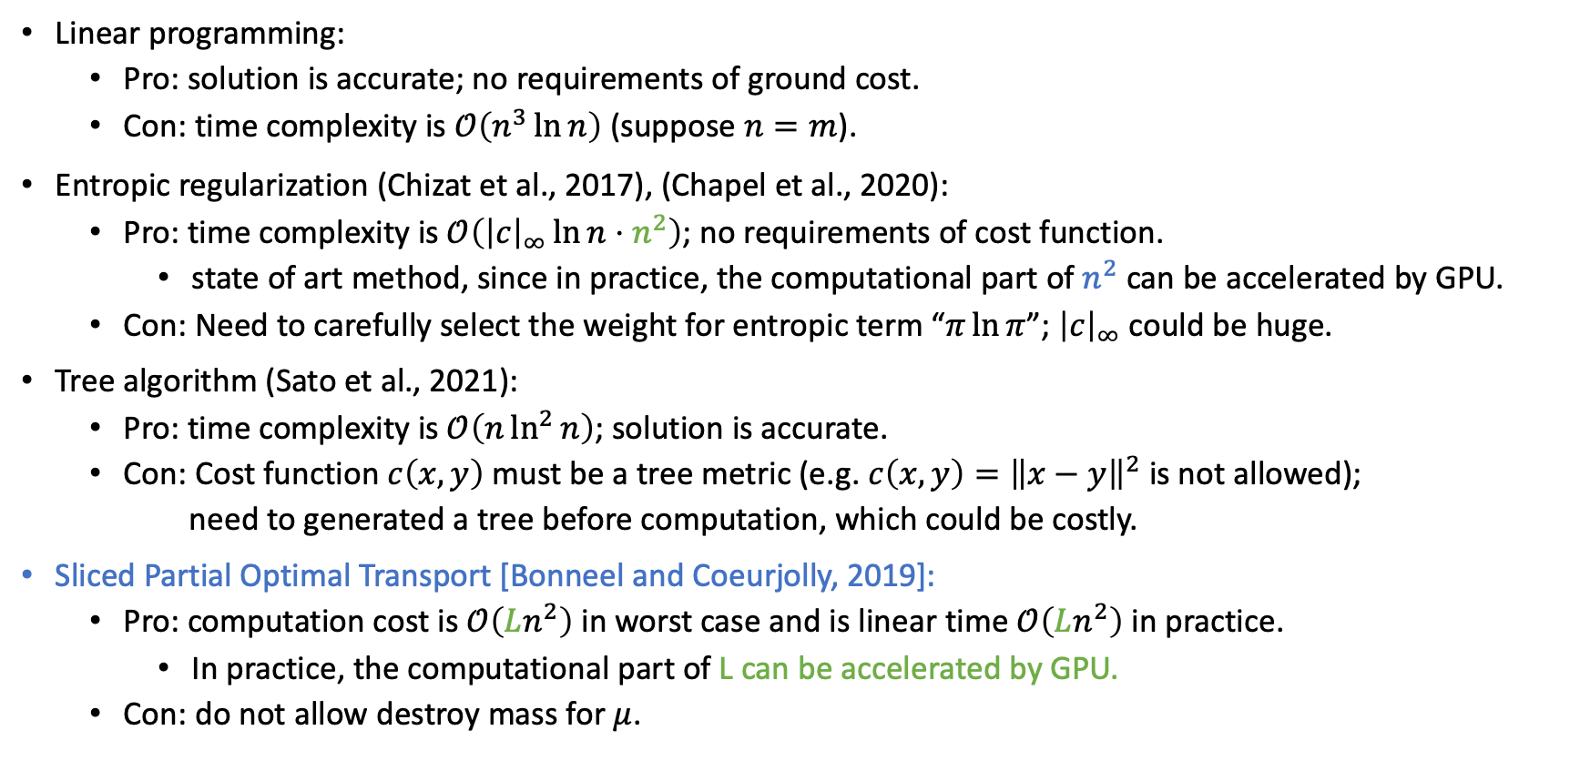
Computation of Empirical OPT
Linear programming:
Pro: solution is accurate; no requirements of ground cost.
Con: time complexity is $𝒪\left(n^{3}\ln{n}\right)$ (suppose $n=m$).
Entropic regularization (Chizat et al., 2017), (Chapel et al., 2020):
Pro: time complexity is $𝒪\left({\left|c\right|}_{∞}\ln{n}⋅n^{2}\right)$; no requirements of cost function.
state of art method, since in practice, the computational part of $n^{2}$ can be accelerated by GPU.
Con: Need to carefully select the weight for entropic term “$π\ln{π}$”; ${\left|c\right|}_{∞}$ could be huge.
Tree algorithm (Sato et al., 2021):
Pro: time complexity is $𝒪\left(n\ln^{2}{n}\right)$; solution is accurate.
Con: Cost function $c\left(x,y\right)$ must be a tree metric (e.g. $c\left(x,y\right)={\left\|x−y\right\|}^{2}$ is not allowed);
need to generated a tree before computation, which could be costly.
Sliced Partial Optimal Transport [Bonneel and Coeurjolly, 2019]:
Pro: computation cost is $𝒪\left(Ln^{2}\right)$ in worst case and is linear time $𝒪\left(Ln^{2}\right)$ in practice.
In practice, the computational part of L can be accelerated by GPU.
Con: do not allow destroy mass for $μ$.

Slide 21
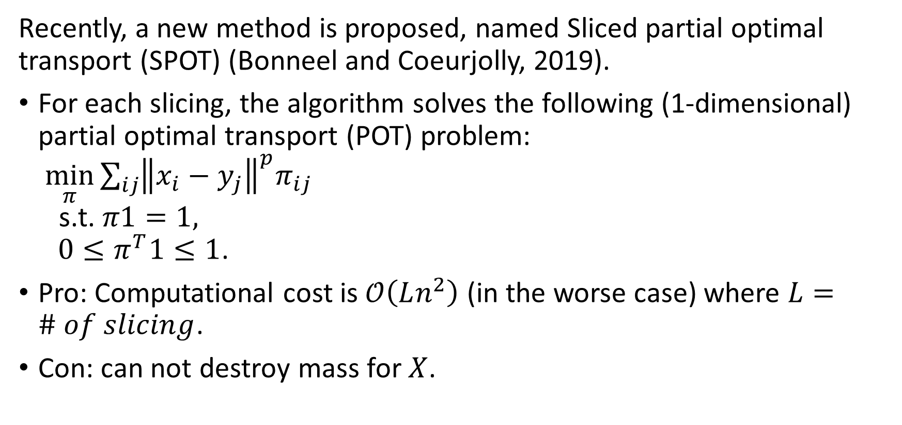
Sliced Partial Optimal Transport
Recently, a new method is proposed, named Sliced partial optimal transport (SPOT) (Bonneel and Coeurjolly, 2019).
For each slicing, the algorithm solves the following (1-dimensional) partial optimal transport (POT) problem: $\min_{π}{\sum_{ij}{{\left\|x_{i}−y_{j}\right\|}^{p}π_{ij}}}$ s.t. $π1=1,$ $0≤π^{T}1≤1$.
Pro: Computational cost is $𝒪\left(Ln^{2}\right)$ (in the worse case) where $L=\# of slicing$.
Con: can not destroy mass for $X$.

Slide 22
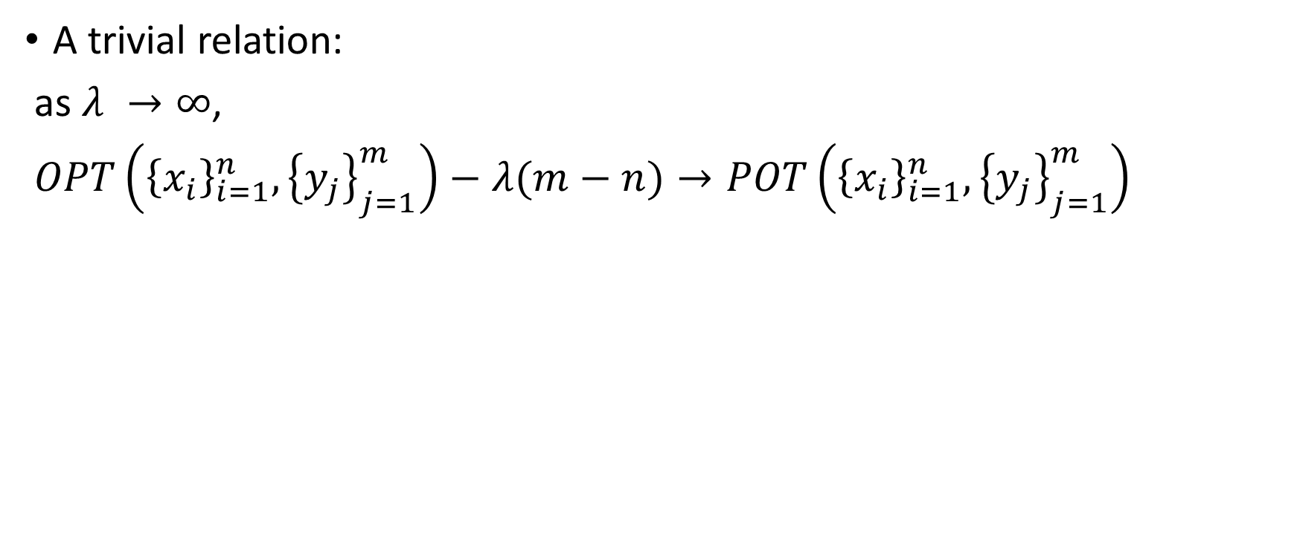
Relation between OPT and POT
A trivial relation:
as $λ →∞$,
$OPT\left({\left\{x_{i}\right\}}_{i=1}^{n},{\left\{y_{j}\right\}}_{j=1}^{m}\right)−λ(m−n)→POT\left({\left\{x_{i}\right\}}_{i=1}^{n},{\left\{y_{j}\right\}}_{j=1}^{m}\right)$

Slide 23
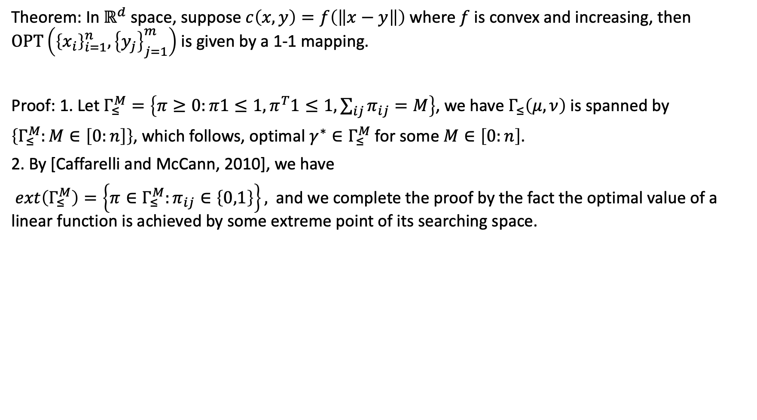
Theoretical result of empirical OPT
Theorem: In $ℝ^{d}$ space, suppose $c\left(x,y\right)=f\left(\left\|x−y\right\|\right)$ where $f$ is convex and increasing, then $OPT\left({\left\{x_{i}\right\}}_{i=1}^{n},{\left\{y_{j}\right\}}_{j=1}^{m}\right)$ is given by a 1-1 mapping.
Proof: 1. Let $Γ_{≤}^{M}=\left\{π≥0:π1≤1,π^{T}1≤1,\sum_{ij}{π_{ij}}=M\right\}$, we have $Γ_{≤}\left(μ,ν\right)$ is spanned by
$\left\{Γ_{≤}^{M}:M∈\left[0:n\right]\right\}$, which follows, optimal $γ^{∗}∈Γ_{≤}^{M}$ for some $M∈\left[0:n\right]$.
2. By [Caffarelli and McCann, 2010], we have
$ext\left(Γ_{≤}^{M}\right)=\left\{π∈Γ_{≤}^{M}:π_{ij}∈\left\{0,1\right\}\right\},$ and we complete the proof by the fact the optimal value of a linear function is achieved by some extreme point of its searching space.

Slide 24
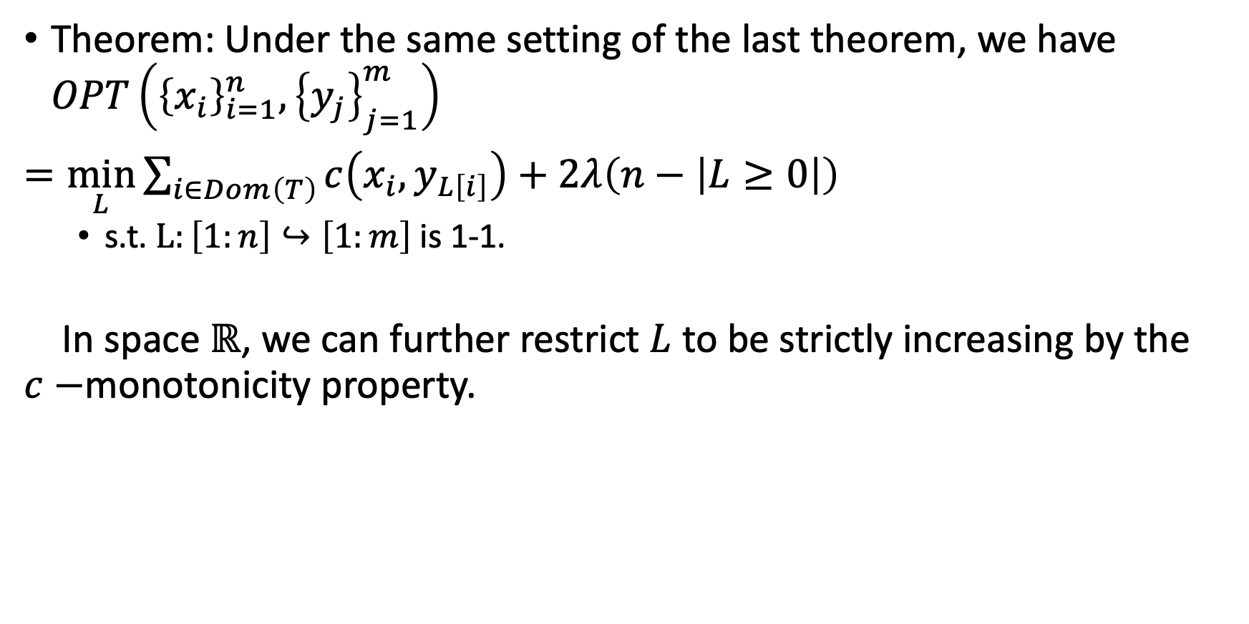
Theoretical result of empirical OPT
Theorem: Under the same setting of the last theorem, we have $OPT\left({\left\{x_{i}\right\}}_{i=1}^{n},{\left\{y_{j}\right\}}_{j=1}^{m}\right)$
$=\min_{L}{\sum_{i∈Dom\left(T\right)}{c\left(x_{i},y_{L\left[i\right]}\right)}+2λ\left(n−\left|L≥0\right|\right)}$
s.t. $L:\left[1:n\right]↪\left[1:m\right]$ is 1-1.
In space $ℝ$, we can further restrict $L$ to be strictly increasing by the $c−$monotonicity property.

Slide 25
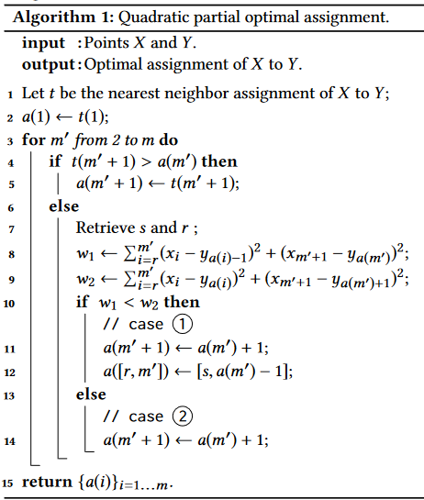
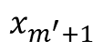
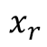
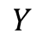
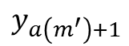
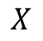
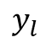
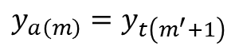
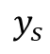
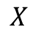















Algorithm of 1D-POT
conflict:
$$X$$
$$x_{r}$$
$$x_{m^{′}}$$
$$x_{m^{′}+1}$$
$$Y$$
$$y_{s}$$
$$y_{a\left(m\right)}=y_{t\left(m^{′}+1\right)}$$
case 1:
$$X$$
$$x_{r}$$
$$x_{m^{′}}$$
$$x_{m^{′}+1}$$
$$Y$$
$$y_{l}$$
$$y_{s}$$
$$y_{a\left(m^{′}\right)}$$
$$y_{a\left(m^{′}\right)+1}$$
case 2:
$$X$$
$$x_{r}$$
$$x_{m^{′}}$$
$$x_{m^{′}+1}$$
$$Y$$
$$y_{l}$$
$$y_{s}$$
$$y_{a\left(m^{′}\right)}$$

Slide 26


Algorithm for 1D OPT
Main idea: we solve the problem in n iterations:
In each iteration k, we solve the problem $OPT\left({\left\{x_{i}\right\}}_{i=1}^{k},{\left\{y_{j}\right\}}_{j=1}^{m}\right)$:
Case 1: no conflict.

Slide 27


Algorithm for 1D OPT
Main idea: we solve the problem in n iterations:
In each iteration k, we solve the problem $OPT\left({\left\{x_{i}\right\}}_{i=1}^{k},{\left\{y_{j}\right\}}_{j=1}^{m}\right)$
Case 2: conflict

Slide 28

Solve the subproblem
Only need to go through all the transportation plans which destroy 1 or 0 point.

Slide 29


Algorithms

Slide 30


Correctness
Theorem: Under the assumptions above, the algorithm opt-1d solve the problem $opt_{λ}\left({\left\{x_{i}\right\}}_{i=1}^{n},{\left\{y_{j}\right\}}_{j=1}^{m}\right)$.

Slide 31


Correctness: numerical experiment
${\left\{x_{i}\right\}}_{i=1}^{n}∼iid unif\left(\left[−20,20\right]\right),{\left\{y_{j}\right\}}_{j=1}^{m}\sim iid unif\left(\left[−40,40\right]\right)$.

Slide 32


Time complexity
Worst case: $𝒪\left(n^{3}\right)$.

Slide 33

Sliced OPT
In $ℝ^{d}$ space, $μ,ν∈ℳ_{+}\left(ℝ^{d}\right)$, $λ:𝕊^{d−1}→ℝ_{++}$, we define sliced optimal partial transport problem as follows:
$sopt_{λ}\left(μ,ν\right)=\int_{𝕊^{d−1}}{opt_{λ\left(θ\right)}\left({\left\langle θ,⋅\right\rangle }_{\#}μ,{\left\langle θ,⋅\right\rangle }_{\#}ν\right)}dσ\left(θ\right)$
Theorem: when $c\left(x,y\right)={\left|x−y\right|}^{p}, where p≥1, p−th power of sopt_{λ}\left(μ,ν\right)$ defines a metric.

Slide 34


Application: point cloud registration
Problem setup: Given 3-d ${\left\{x_{i}\right\}}_{i=1}^{n},{\left\{y_{j}\right\}}_{j=1}^{m}$, for each $y_{j}$, $y_{j}=T\left(x_{i}\right)$ for some $x_{i}$. The correspondence is unknown.
$Tx=sRx+β$.
$R$ is rotation, $β$ is translation.
Both source and target data
are corrupted with noise.

Slide 35

Performance:

Slide 36

Limitation and Future work:
Limitation:
Suppose we want to transport $n_{0}<n$ point, how to select $λ$ before solving the problem?
If can be solved, we can define sopt-barycenter, sopt-gradient flow, similar to sliced-OT.
Future’s work:
For opt, extend the algorithm into non-uniform discrete measures setting.
Extend the sliced OT technique into multi-marginal OT setting.

Slide 37










Algorithm for 1D OPT
$$j_{k}=\arg{\min_{j∈\left[1:m\right]}\left\{c\left(x_{k},y_{j}\right)\right\}}$$
Main idea: we solve the problem in n iterations:
In each iteration k, we solve the problem $OPT\left({\left\{x_{i}\right\}}_{i=1}^{k},{\left\{y_{j}\right\}}_{j=1}^{m}\right)$
$$cost 2=cost+c\left(x_{k},y_{j_{last}+1}\right)$$
$$X x_{1} x_{2} x_{3} x_{4} x_{k}$$
$$X x_{1} x_{2} x_{3} x_{4} x_{k}$$
$$Y y_{1} y_{2} y_{3} y_{4} y_{last}=y_{j_{k}}$$
$$Y y_{1} y_{2} y_{3} y_{4} y_{j_{last}} y_{j_{last}+1}$$
$$cost 3=cost\left(OPT\left({\left\{x_{i}\right\}}_{i=1}^{k−1},{\left\{y_{j}\right\}}_{j=1}^{j_{last}−1}\right)\right)+c\left(x_{k},y_{j_{last}}\right)$$
$$cost 0=cost+2λ$$
$$X x_{1} x_{2} x_{3} x_{4} x_{k}$$
$$X x_{1} x_{2} x_{3} x_{4} x_{k}$$
$$Y y_{1} y_{2} y_{3} y_{4} y_{last}$$
$$Y y_{1} y_{2} y_{3} y_{4} y_{last} y_{last+1}$$
Solve by OPT-1D
$$cost=min \left\{cost 0, cost 1c, cost 2c\right\}$$

Slide 38


Algorithm for 1D OPT (version 1)
Notation:
Cost: optimal value of $OPT\left({\left\{x_{i}\right\}}_{i=1}^{k},{\left\{y_{j}\right\}}_{j=1}^{m}\right)$
$L$: optimal transportation plan, $L\left[i\right]=j$ denotes $x_{i}→y_{j}$ and $L\left[i\right]=−1$ denotes we destroy $x_{i}$.
$j_{k}$: the index of $y$ which is closest to $x_{k}$.
$j_{last}$: the index of $y$ last assigned

Slide 39





Performance
Accuracy: Theorem: After iteration $k$, OPT-1D-V1 solve the problem $OPT\left({\left\{x_{i}\right\}}_{i=1}^{k},{\left\{y_{j}\right\}}_{j=1}^{m}\right)$ for each $k$.
Proof by induction.
Time complexity. Best case: $𝒪\left(n\right)$ (No conflict)
Worst case: $𝒪\left(2^{n}\right)$ (There is conflict in each iteration)
$$X x_{1} x_{2} x_{3}$$
$$Y y_{1} y_{2} y_{3} y_{4}$$
$$X x_{1} x_{2} x_{3}$$
$$Y y_{1} y_{2} y_{3}$$

Slide 40

Experiment 1: OPT and OT
Set-up:${\left\{x_{i}\right\}}_{i=1}^{n}∼i.i.d. Unif\left[0,10\right], n=30,$ ${\left\{y_{j}\right\}}_{j=1}^{m}∼i.i.d. Unif\left[5,20\right],m=30$

Slide 41


Experiment 2: OPT and POT
Set-up: ${\left\{x_{i}\right\}}_{i=1}^{n}∼iid Unif\left[0,10\right], n=20$ ${\left\{y_{j}\right\}}_{j=1}^{m}∼iid Unif\left[5,20\right],m=30$

Slide 42

Algorithm for 1D OTP (Version 2)
How to improve the reduce the time complexity of OPT-v1?
The key point is, in iteration $k$, for the subproblem $OPT\left({\left\{x_{i}\right\}}_{i=1}^{k},{\left\{y_{j}\right\}}_{j=1}^{j_{last}−1}\right)$, we need an efficient way to solve it: either reduce the problem-size or solve it based on the solution in previous iteration.

Slide 43


Algorithm for 1D OTP (Version 2)
Lemma 1?: Consider problem $OPT\left({\left\{x_{i}\right\}}_{i=1}^{k−1},{\left\{y_{j}\right\}}_{j=1}^{m}\right)$, let $L^{\left(k−1\right)}$ be one optimal plan. Suppose $L^{\left(k−1\right)}\left[k−1\right]=−1$ and $L\left[i\right]≥0,∀i≤k−2$.
Then for problem $OPT\left({\left\{x_{i}\right\}}_{i=1}^{k},{\left\{y_{j}\right\}}_{j=1}^{m}\right)$, there exists an optimal mapping, denoted as $L^{\left(k\right)}$ such that $L^{\left(k\right)}\left[0:k−1\right]=L^{\left(k−1\right)}\left[0:k−1\right]$ .
Lemma 2: If $L^{\left(k−1\right)}\left[k^{′}\right]=−1$ for some $k^{′}≥0$ and $L\left[i\right]≥0,∀i≠k^{′},t$hen for problem $OPT\left({\left\{x_{i}\right\}}_{i=1}^{k},{\left\{y_{j}\right\}}_{j=1}^{m}\right)$, there exists optimal plan, denoted as $L^{\left(k\right)} such that$ $L^{\left(k\right)}\left[0:k^{′}\right]=L^{\left(k−1\right)}\left[0:k^{′}\right]$.
Sketch of Proof: If $k^{′}=k−1$, we’ve done by lemma 1. We suppose $k^{′}=k−2$.
Assume it is not true. Then there is optimal $L$ such that $L\left[k^{′}\right]≥0$. Then we have $L\left[k\right]=L^{\left(k−1\right)}\left[k−1\right]$ and $L\left[k−2\right]=L^{\left(k−1\right)}\left[k−3\right]$. But by define $L\left[0:k−2\right]=L^{\left(k−1\right)}\left[0:k−2\right]$, we can find a better plan. So it is contradiction. Similar for $k^{′}=k−3,k−4,…1$.
$$X:x_{0} x_{1} x_{k^{′}} x_{i_{start}} x_{k}$$
$$Y:y_{0} y_{1} y_{j_{start}} y_{j_{start}+1}$$

Slide 44

Algorithm for 1D OTP (Version 2)
Theorem 1: Consider problem $OPT\left({\left\{x_{i}\right\}}_{i=1}^{k−1},{\left\{y_{j}\right\}}_{j=1}^{m}\right)$, let $L^{\left(k−1\right)}$ be one optimal plan.
Suppose $L\left[i\right]=−1$ for some $i$ and let $k^{′}=\arg{\max_{i}\left\{L\left[i\right]=−1\right\}}$.
Then for problem $OPT\left({\left\{x_{i}\right\}}_{i=1}^{k},{\left\{y_{j}\right\}}_{j=1}^{m}\right)$, there exists an optimal plan, denoted as $L^{\left(k\right)}$ such that $L^{\left(k\right)}\left[1:k^{′}\right]=L^{\left(k−1\right)}$.
Proof: Prove by induction and Lemma 2.

Slide 45



Algorithm: 1D OPT (V2)
conflict
Pre-problem
Pre-problem
$x_{1} x_{2} x_{i_{d}} x_{i_{d}+1} { x}_{k−1} x_{k}$
$x_{1} x_{2} x_{k^{′}} x_{i_{d}+1} x_{k−1} x_{k}$
$$y_{1} y_{j_{d}} y_{j_{d}+1} y_{j_{last}−1} y_{j_{last}} y_{j_{last}+1}$$
$$y_{1} y_{2} y_{j_{start}} y_{j_{last}} y_{j_{last}+1}$$
$$cost_{0}=cost+λ$$
Pre-problem
Pre-problem
$x_{1} { x}_{2} x_{i_{d}} x_{i_{start}} x_{k−1} x_{k}$
$x_{1} x_{2} x_{k^{′}} x_{i_{start}} x_{k−1} x_{k}$
$$y_{1} y_{2} y_{j_{start}} y_{j_{last}−1} y_{j_{last}} y_{j_{last}+1}$$
$$y_{1} y_{2} y_{j_{start}} y_{j_{last}−1} y_{j_{last}} y_{j_{last}+1}$$
$$cost_{1}=cost+c\left(x_{k},y_{j_{last}+1}\right)$$
$$cost=min \left\{cost 0, cost 2, cost 3\right\}$$
$$cost 3=C\left(L\left[1:i_{d}\right]\right)+cost_{sub}+c\left(x_{k},y_{j_{last}}\right)$$

Slide 46
Algorithm: 1D OPT (V2): update previous problem
Pre-problem
$x_{1} x_{2} x_{k^{′}} x_{i_{start}} { x}_{k−1} x_{k}$
$$y_{1} y_{2} y_{j_{start}} y_{j_{last}−1} y_{j_{last}} y_{j_{last}+1}$$
If Cost 3 is the minimum:
If Cost 0 is the minimum:
Pre-problem
Pre-problem
$x_{1} x_{2} x_{3} x_{4} { x}_{k−1} x_{k} x_{i_{start}}$
$x_{1} x_{2} x_{3} x_{4} { x}_{k−1} x_{i_{start}} x_{k+1}$
$$y_{1} y_{2} y_{3} y_{j_{last}−1} y_{j_{last}} y_{j_{start}}$$
$$y_{1} y_{2} y_{3} y_{k^{′}} y_{j_{start}} y_{j_{start}+1}$$

Slide 47

Solve the subproblem by previous plan
Theorem 3: Let $L^{\left(k−1\right)}$ be one optimal plan for problem $OPT\left({\left\{x_{i}\right\}}_{i=1}^{k−1},{\left\{y_{j}\right\}}_{j=1}^{m}\right)$, let $k^{′}=\arg{\max_{i}\left\{L^{\left(k−1\right)}\left[i\right]=−1\right\}}$, let $i_{start}=k^{′}+1$ and $j_{start}=\max\left\{L\left[i\right]:i≤k^{′}\right\}$. For sub problem $OPT\left({\left\{x_{i}\right\}}_{i=i_{start}}^{k−1},{\left\{y_{j}\right\}}_{j=j_{start}}^{j_{last}}\right)$, there exists mapping, denoted as $L_{sub}$ such that $\#\left\{i:L_{sub}\left[i\right]=−1\right\}≤1$.
That is, for the subproblem, we only need to go through all the plans who destroy one point or zero point.
Can be proved by induction.
Note, suppose $\#{\left\{x_{i}\right\}}_{i=i_{start}}^{k−1}=k−1−i_{start}=s$, then there is at most $s$ plans, which destroy one point, and there is a unique optimal plan which destroy zero point. Thus we only need to compute the costs of $s+1$ plans can compare them. The time complexity is at most $s\left(s+1\right)$.
In practice, it can be facilitated by computation in parallel.

Slide 48
Solve the subproblem by previous plan
Theorem 3: Let $L^{\left(k−1\right)}$ be one optimal plan for problem $OPT\left({\left\{x_{i}\right\}}_{i=1}^{k−1},{\left\{y_{j}\right\}}_{j=1}^{m}\right)$, let $k^{′}=\arg{\max_{i}\left\{L^{\left(k−1\right)}\left[i\right]=−1\right\}}$, let $i_{start}=k^{′}+1$ and $j_{start}=\max\left\{L\left[i\right]:i≤k^{′}\right\}$. For sub problem $OPT\left({\left\{x_{i}\right\}}_{i=i_{start}}^{k−1},{\left\{y_{j}\right\}}_{j=j_{start}}^{j_{last}}\right)$, there exists mapping, denoted as $L_{sub}$ such that $\#\left\{i:L_{sub}\left[i\right]=−1\right\}≤1$.
That is, for the subproblem, we only need to go through all the plans who destroy one point or zero point.
Can be proved by induction.
Note, suppose $\#{\left\{x_{i}\right\}}_{i=i_{start}}^{k−1}=k−1−i_{start}=s$, then there is at most $s$ plans, which destroy one point, and there is a unique optimal plan which destroy zero point. Thus we only need to compute the costs of $s+1$ plans can compare them. The time complexity is at most $s\left(s+1\right)$.
In practice, it can be facilitated by computation in parallel.

Slide 49









Solve the subproblem
Sub problem: $OPT\left({\left\{x_{i}\right\}}_{i=i_{start}}^{k−1},{\left\{y_{j}\right\}}_{j=j_{start}}^{j_{last}−1}\right)$
inactive problem
active problem
$$x_{i_{active}}$$
$$x_{k−1}$$
$$x_{k}$$
$$x_{i_{start}}$$
$$y_{j_{active}}$$
$$y_{j_{start}}$$
$$y_{j_{last}}$$
Store: $cost_{inact},L_{inact}$

Slide 50















Solve the subproblem
Sub problem: $OPT\left({\left\{x_{i}\right\}}_{i=i_{start}}^{k−1},{\left\{y_{j}\right\}}_{j=j_{start}}^{j_{last}−1}\right)$
inactive problem
active problem
Destroy $x_{k}$
Destroy $x_{k−1}$
Store: $cost_{inact},L_{inact}$
$$x_{i_{act}+2}$$
$$x_{i_{act}+1}$$
$$x_{i_{start}}$$
$$x_{i_{act}}$$
$$x_{k−1}$$
$$x_{k}$$
$$y_{j_{act}}$$
$$y_{j_{act}+1}$$
$$y_{j_{act}+2}$$
$$y_{j_{act}+3}$$
$$y_{start}$$
$$y_{j_{last}}$$
$cost_{act−d1}$,
$$cost_{pre−act−d1}$$

Slide 51












Solve the subproblem
Sub problem: $OPT\left({\left\{x_{i}\right\}}_{i=i_{start}}^{k−1},{\left\{y_{j}\right\}}_{j=j_{start}}^{j_{last}−1}\right)$
inactive problem
active problem
Destroy $x_{k−2}$
Store: $cost_{inact},L_{inact}$
$$x_{i_{act}}$$
$$x_{k−2}$$
$$x_{k−1}$$
$$x_{k}$$
$$x_{i_{start}}$$
Stop if $≥2λ$
$$y_{j_{act}}$$
$$y_{start}$$
$$cost_{act−pre−d1}$$
$$y_{j_{last}}$$
$$cost_{act−d1}$$

Slide 52








Solve the subproblem
Sub problem: $OPT\left({\left\{x_{i}\right\}}_{i=i_{start}}^{k−1},{\left\{y_{j}\right\}}_{j=j_{start}}^{j_{last}−1}\right)$
active problem
inactive problem
Destroy $x_{k−3}$
Store: $cost_{inactive},L_{inactive}$
$$x_{i_{act}}$$
$$x_{k−3}$$
$$x_{k−2}$$
$$x_{k−1}$$
$$x_{k}$$
$$x_{i_{start}}$$
Stop if $≥2λ$
$$y_{j_{act}}$$
$$y_{start}$$
$$y_{j_{last}}$$
$$cost_{pre−act−d1}$$
$$cost_{act−d1}$$

Slide 53












Solve the subproblem
Sub problem: $OPT\left({\left\{x_{i}\right\}}_{i=i_{start}}^{k−1},{\left\{y_{j}\right\}}_{j=j_{start}}^{j_{last}−1}\right)$
active problem
inactive problem
Destroy $x_{i_{active}}$
Store: $cost_{inactive},L_{inactive}$
$$x_{i_{act}}$$
$$x_{k−3}$$
$$x_{k−2}$$
$$x_{k−1}$$
$$x_{k}$$
$$x_{i_{start}}$$
Stop if $≥2λ$
$$y_{j_{s}}$$
$$y_{start}$$
$$y_{j_{last}}$$
$cost_{pre−act}$=0
$$cost_{act−d_{1}}$$
Find the optimal cost $cost_{d1}$

Slide 54






Solve the subproblem
Sub problem: $OPT\left({\left\{x_{i}\right\}}_{i=i_{start}}^{k−1},{\left\{y_{j}\right\}}_{j=j_{start}}^{j_{last}−1}\right)$
active problem
inactive problem
Destroy $x_{i_{active}}$
$$x_{i_{start}}$$
$$x_{i_{active}}$$
$$x_{k−3}$$
$$x_{k−2}$$
$$x_{k−1}$$
$$x_{k}$$
Stop if $≥2λ$
$$y_{j_{active}}$$
$$y_{start}$$
$$y_{j_{last}}$$
Store: $cost_{inact},$
$$L_{inact}$$
$$cost_{act−d_{0}}$$

Slide 55


Algorithm for 1D OTP (Version 2)

Slide 56

Performance of OPT-V2
Accuracy:
Theorem 4: in each iteration $k$, $OPT−v2$ returns one optimal solution which solves $OPT\left({\left\{x_{i}\right\}}_{i=1}^{k},{\left\{y_{j}\right\}}_{j=1}^{m}\right)$.
Proof: By lemma 2, we can divide the problem into to parts and the “previous problem” has been solved. By theorem 3, the subproblem is solved by the function “sub-opt”. Thus opt-v2 solve the problem by induction.
Computational cost:
Suppose every $s$ points, we destroy one point, then the computational cost is at most $\sum_{s^{′}=1}^{s}{s^{′}\left(s^{′}+1\right)}=\frac{1}{3}s\left(s+1\right)\left(s+2\right)$. Thus the time complexity is at most $\frac{n}{s}s^{3} =\frac{1}{3}n\left(s+1\right)\left(s+2\right)$ where $s≪n$ in general.
In practice, we can accelerate the algorithm sub_opt by computation in parallel. Thus the time complexity is at most $O\left(ns\right)$ where $s≤n$ and depends on the data and $λ$.

Slide 57

Experiment 3: Accuracy of our methods
$${\left\{x_{i}\right\}}_{i=1}^{n}∼Unif\left(\left[0,10\right]\right),{\left\{y_{j}\right\}}_{j=1}^{m}∼Unif\left(\left[5,20\right]\right),λ=5$$

Slide 58


Experiment 4: time complexity of our methods
$${\left\{x_{i}\right\}}_{i=1}^{n}∼Unif\left(\left[0,10\right]\right),{\left\{y_{j}\right\}}_{j=1}^{m}∼Unif\left(\left[5,20\right]\right),λ=8$$
Tips:
In practice, Sinkhorn algorithm needs more time
since the iteration time should be $Ω\left(\ln\left(n\right)\right)$.

Slide 59

Sliced OPT
Theorem: Let $p≥1.$ In $ℝ^{d}$ space, suppose $μ,ν∈𝒫_{p}\left(ℝ^{d}\right)$ and $c\left(x,y\right)={\left\|x−y\right\|}^{p},$ we define sliced optimal partial transport distance
$sliced−opt\left(μ,ν\right)≔\int{opt\left(μ^{θ},ν^{θ};λ_{θ} \right)dσ(θ)}$, where $supp\left(σ\right)=𝕊^{d−1}$ and $λ_{θ}>0,∀θ$, then
$sliced−opt\left(μ;ν\right)$ defines a metric.

Slide 60


Application 1: shape registration problem
Consider two dataset $X_{0}={\left\{x_{i}\right\}}_{i=1}^{N}⊂ℝ^{3},Y_{0}={\left\{y_{j}\right\}}_{j=1}^{N}$
with $x_{i}=s^{∗}R^{∗}y_{i}+β^{∗}$ where $s^{∗}>0,β^{∗}∈ℝ^{3},R^{∗}$ is rotation matrix.
$X_{1}=X_{0}∪{\left\{{\left(n_{x}\right)}_{i}\right\}}_{i=1}^{n}, Y_{1}=Y_{0}∪{\left\{{\left(n_{y}\right)}_{j}\right\}}_{j=1}^{n}$
n/N is given (we have prior knowledge of proportion of noise)
Given $X_{1},Y_{1}$, how to estimate $\left\{s^{∗},R^{∗},β^{∗}\right\}$ ?
Sometimes, it could be an ill posed problem. (The solution may not be unique).

Slide 61


Shape registration 1
Our method:
Initialize $λ R,β,s$
For i in range (n_iterations):
${\hat{X}}_{1}←sRY_{1}+β$
Select $θ∈𝕊^{2}$, and compute projections $X_{1}^{θ}←θ^{T}X_{1},{\hat{X}}_{1}^{θ}←θ^{T}{\hat{X}}_{1}$.
Solve $OPT\left({\hat{X}}_{1}^{θ},X_{1}^{θ};λ\right)$ and let $L$ denote the transportation plan.
Let $Dom\left(L\right)←\left\{i:L\left[i\right]≥0\right\}$.
${\hat{X}}_{trans}←{\hat{X}}_{1}\left[dom\left(L\right)\right],{\hat{X}}_{trans}^{θ}←{\hat{X}}_{1}^{θ}\left[dom\left(L\right)\right];$
$Y_{trans}=Y_{1}\left[dom\left(L\right)\right];$
$X_{trans}^{θ}← X_{1}^{θ}\left[L\left[L≥0\right]\right]$
Let ${\hat{X}}_{trans}←{\hat{X}}_{trans}+\left(X_{trans}^{θ}−{\hat{X}}_{trans}^{θ}\right)θ$
$U,S,V=SVD\left(Cov\left(Y_{trans},{\hat{X}}_{trans}\right)\right) R=UV^{T}$ (*)
$s=\frac{std\left({\hat{X}}_{trans}\right)}{std\left(Y_{trans}\right)}$
$β=𝔼\left[{\hat{X}}_{trans}\right]−𝔼\left[Y_{trans}\right]$
$mass←\#\left[L≥0\right]$, modify $λ$ based on $mass−diff←mass−n\frac{n}{N}$.
Note: if $Y_{0}=Y_{trams}.{\hat{X}}_{trans}=X_{0}$ in step (*), one can get $R^{∗},s^{∗},β^{∗}$ directly.

Slide 62

Application 2: Task similarity:
Suppose $A={\left\{a_{i}\right\}}_{i=1}^{600}$ where ${\left\{a_{i}\right\}}_{i=1}^{200},{\left\{a_{i}\right\}}_{i=201}^{400},{\left\{a_{i}\right\}}_{i=401}^{600}$ are figures of “0”, “1”, “2” respectively.
$B={\left\{b_{i}\right\}}_{i=1}^{600}$ where ${\left\{b_{i}\right\}}_{i=1}^{200},{\left\{b_{i}\right\}}_{i=201}^{400},{\left\{b_{i}\right\}}_{i=401}^{600}$ are figures of “0”, “3”, “7” respectively.
$C={\left\{c_{i}\right\}}_{i=1}^{600}$ where ${\left\{c_{i}\right\}}_{i=1}^{200},{\left\{c_{i}\right\}}_{i=201}^{400},{\left\{c_{i}\right\}}_{i=401}^{600}$ are figures of “0”, “3”, “shoes” respectively.
For classification problem, set $A,C$ are similar. However
$OT\left(A,B\right)<OT\left(A,C\right)$.
However $SOPT\left(A,B;λ\right)>SOPT\left(A,C;λ\right)$

Slide 63

Future work: Sliced OPT gradient flow:
What is Gradient flow?
In Hilbert space $ℋ$, given $φ:\left[0,1\right]×ℋ→ℝ$ with vector field $v:\left[0,1\right]×ℋ→ℝ$, we aim to solve the flow $x:\left[1,0\right]×ℋ→ℋ$ satisfies:
$$\frac{d}{dt}x\left(t\right)=−∇(φ\left(x\left(t\right)\right)$$
By Implicit Euler method, fix $τ>0$, and define $x_{0}^{τ}=x_{0}$, we can find $x_{k}^{τ}$ for $k=1,2,…$ by solving $\min_{x}{\frac{{\left\|x−x_{k}^{τ}\right\|}^{2}}{τ}+φ\left(x\right)}$.
Wasserstein gradient flow:
Note, $P\left(ℝ^{d}\right)⊂ℳ\left(ℝ^{d}\right)$ is a convex cone and $ℳ\left(ℝ^{d}\right)$ is a Banach space since $\left(ℳ\left(ℝ^{d}\right),{\left\|\right\|}_{TV}\right)={\left(C_{b}\left(ℝ^{d}\right),{\left\|\right\|}_{∞}\right)}^{∗}={\left(C_{0}\left(ℝ^{d}\right),{\left\|\right\|}_{∞}\right)}^{∗}$
We find $μ_{0},μ_{1},….$ by solving $\min_{μ}{\frac{W_{2}^{2}\left(μ_{k}^{τ},μ\right)}{2τ}+φ\left(μ\right)}$.
Application:
When $φ\left(μ\right)$ is negative entropy, the WGF can be used to solve Heat equation.
It is also well known as generative model (GAN) and $φ\left(μ\right)$ is a regularization term.

Slide 64


Future work: Wasserstein Gradient Flow (Liutkus, 2019)
Sliced Wasserstein Gradient flow:
where ${\hat{v}}_{k}\left(z\right)≔\frac{1}{N_{θ}}\sum_{i=1}^{N_{θ}}{\left(z−F_{θ_{\#}ν}^{−1}∘F_{θ_{\#}{\overline{μ}}_{k}}\left(z\right)]\right)θ}$
$≔∂_{x}\frac{1}{N_{θ}}\sum{ψ_{θ}\left(x\right)}$
Question: can we replace $∇_{SOT}W\left(⋅,ν\right)∣_{{\overline{μ}}_{k}}$ by $∇_{SOPT}W\left(⋅,ν\right)∣_{{\overline{μ}}_{k}}?$
Problem: Can we find a relation between mass and $λ$ without solving the problem?

Slide 65

Future work: Sliced OPT Barycenter
Wasserstein Barycenter on $ℝ^{d}:$ Given and index set $I$ and we define the simplex set of weights as
$Λ_{I}=\left\{λ=\left(λ_{i}\right)∈ℝ^{I};∀i∈I, λ_{i}≥0,\sum_{i∈I}{λ_{i}}=1\right\}$, we define problem
$BW{\left(μ_{i},λ_{i}\right)}_{i∈I}=\arg{\min_{μ∈𝒫\left(ℝ^{d}\right)}{\sum_{i∈I}{λ_{i}W^{2}\left(μ_{i},μ \right)}}}$.
$I$ could be uncountable set and the minimizer sill exists (under some regular conditions).
In $ℝ$, the problem has closed form solution:
Choose $μ∈𝒫\left(ℝ\right)$ such that $∀i,μ_{i}≪μ$. Then one minimizer of the WB problem is
$μ^{∗}={\left(\sum_{i∈I}{λ_{i}T_{i}}\right)}_{\#}μ$ where $T_{i}$ denote the optimal mapping such that ${\left(T_{i}\right)}_{\#}μ=μ_{i}.$
Sliced Wasserstein Barycenter:
$BSW{\left(μ_{i},λ_{i}\right)}_{i∈I}=\arg{\min_{μ∈𝒫\left(ℝ^{d}\right)}{\sum_{i∈I}{λ_{i}SW^{2}\left(μ_{i},μ\right)}}}$,
or equivalently, it is the set of $μ∈𝒫\left(ℝ^{d}\right)$ s.t. $∀θ,θ_{\#}μ∈\arg{\min_{μ_{1}∈𝒫\left(ℝ\right)}{\sum_{i∈I}{λ_{i}W^{2}(θ_{\#}μ_{i},θ_{\#}μ})}}.$

Slide 66

Future work: Sliced OPT Barycenter
Radon transform: Given $f∈L^{1}\left(ℝ^{d}\right)$, $R:L^{1}\left(ℝ^{d}\right)→L^{1}\left(ℝ×𝕊^{d−1}\right)$, is defined as
$Rf\left(t,θ\right)=\int_{S_{θ}^{⊥}}{f\left(tθ+θ^{⊥}\right)dγ\left(θ^{⊥}\right)}$ where $S_{θ}≔span\left\{θ\right\}.$
Back-projection operation (the adjoint of $R$): $R^{∗}:C_{0}\left(ℝ×𝕊^{d−1}\right)→C_{0}\left(ℝ^{d}\right)$ with R$R^{∗}g\left(x\right)=\int_{𝕊^{n−1}}{g\left(θ^{T}x,θ\right)dθ}.$
Thus, $R^{∗}Rf=h∗f$ where $h=ℱ^{−1}\left(c{\left\|ω\right\|}^{−\left(d−1\right)}\right)$
And we can derive the inverse Randon transform as $g↦h^{+}∗\left(R^{∗}g\right)$ where $h^{+}=ℱ^{−1}\left(\frac{1}{c}\left\|ω\right\|\right)$
Random (Inverse Randon) transform of measure can be defined in a similar way.
Question: Can we construct sliced opt Barycenter?
Problem: how to solve the 1-D OPT Barycenter problem?

Slide 67

Future work: Multimarginal OT
Multimarginal OT (MMOT):
$\inf_{γ}{\int_{X}{c\left(x_{1},…x_{m}\right)dγ\left(x_{1},…x_{m}\right)}}$ such that ${\left(π_{i}\right)}_{\#}γ=μ_{i},∀i$.
# of marginals could be uncountable, thus $γ∈𝒫\left(\left[0,1\right]×ℝ^{d}\right)$.
Wasserstein Barycenter is a particular multimarginal OT problem, indeed:
$\min_{μ}{\sum_{i=1}^{m}{λ_{i}W_{2}^{2}\left(μ_{i},μ\right)}}$ is equivalent to $\min_{γ∈Γ\left(μ_{1},…μ_{m}\right)}{\int{\sum_{i<j}{\frac{λ_{i}λ_{j}}{2}{\left|x_{i}−x_{j}\right|}^{2}}dP}}$.
Computational method: Sinkhorn:
Entropic regularized MMOT:
$\inf_{γ}{\int_{X}{cdγ}+λ\int{\ln{λ}dλ}}=\inf_{γ}{KL\left(γ | K\right)}$
Question:
Can we develop sliced based method for MMOT?
Difficulty: The reason we use project measures to 1-D space is space $ℝ$ has order, for multi marginal OT problem, could we still use order of $ℝ$?

Slide 68
References
Caffarelli, L., McCann, R., 2010. Free boundaries in optimal transport and Monge-Ampère obstacle problems. Ann. Math. 171, 673–730. https://doi.org/10.4007/annals.2010.171.673
Chapel, L., Alaya, M.Z., Gasso, G., 2020. Partial Optimal Transport with Applications on Positive-Unlabeled Learning. ArXiv200208276 Cs Stat.
Chizat, L., Peyré, G., Schmitzer, B., Vialard, F.-X., 2019. Unbalanced Optimal Transport: Dynamic and Kantorovich Formulation. ArXiv150805216 Math.
Chizat, L., Peyré, G., Schmitzer, B., Vialard, F.-X., 2017. Scaling Algorithms for Unbalanced Transport Problems. ArXiv160705816 Math.
Figalli, A., 2010. The Optimal Partial Transport Problem. Arch. Ration. Mech. Anal. 195, 533–560. https://doi.org/10.1007/s00205-008-0212-7
Liero, M., Mielke, A., Savaré, G., 2018. Optimal Entropy-Transport problems and a new Hellinger–Kantorovich distance between positive measures. Invent. Math. 211, 969–1117. https://doi.org/10.1007/s00222-017-0759-8
Sato, R., Yamada, M., Kashima, H., 2021. Fast Unbalanced Optimal Transport on a Tree. ArXiv200602703 Cs Stat.

